Slide 1

Happiness and Life Satisfaction World Happiness Report 2021 with EDA

Slide 2
World Happiness Report 2021
Focus on people’s live
Report
149x7 observation
Evaluate how goverments all over the world

Slide 3
Factors
happiness
health
public life
security
economic

Slide 4
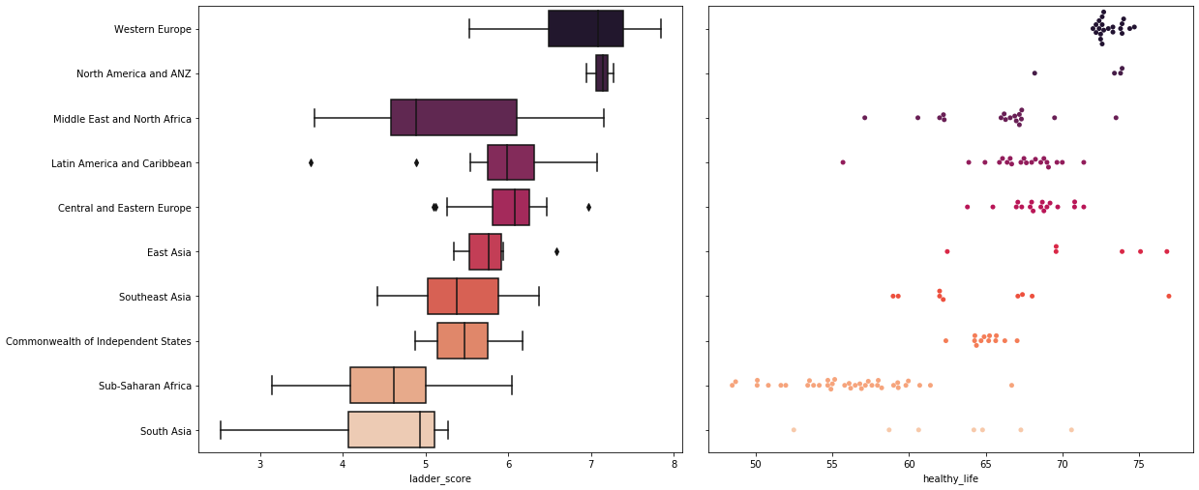
Life expectancy and life satisfaction

Slide 5
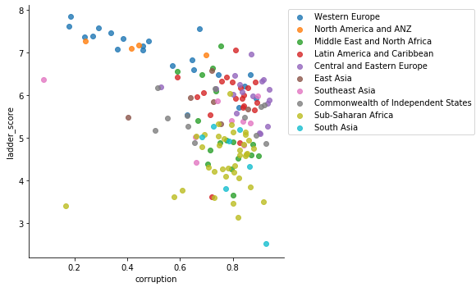
Corruption

Slide 6
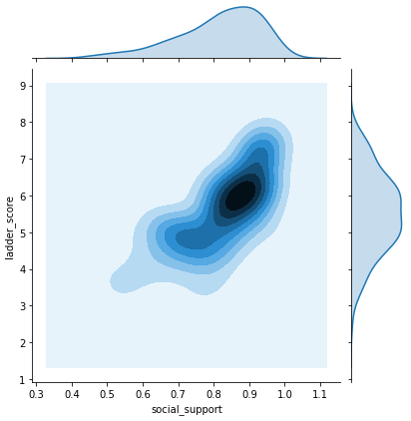
Social support

Slide 7
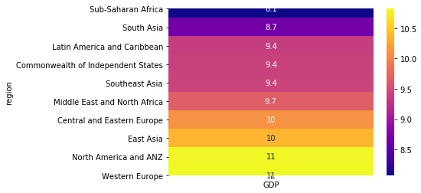
Economics

Slide 8
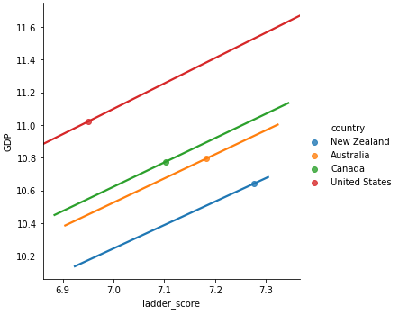
Happiness inequality

Slide 9
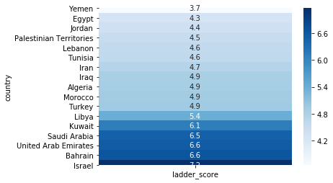
Appendix
What about Turkey?
ranks 103rd /149th

Slide 10
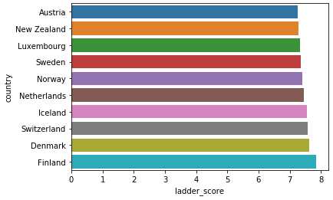
Top 10

Slide 11
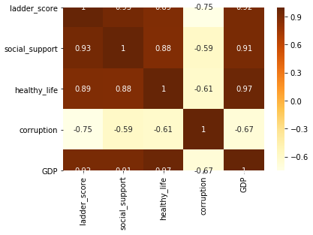
Why are these criteria used?

Slide 12
Future Work
What is happiness in the world from yesterday to today?
This report has been prepared with 2021 data.
It is planned to make cross-country analysis with time series.
We will focuses on the effects of COVID-19 and how people all over the world have fared.

Slide 13


